Slide 1
Habitual goals
Adam Morris

Slide 2
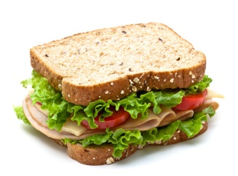

Slide 3
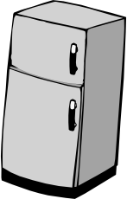
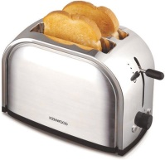
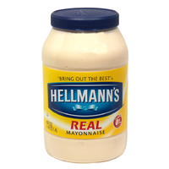
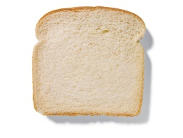
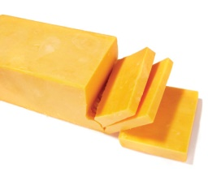
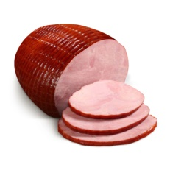

Planning towards goals
Subsubgoals
Subgoals
Goal
Context
Notes:
Suppose I’m hungry.
How do I solve this problem?
I could set the goal of making a sandwich.
But you know that, in order to complete that goal, you need to…
And in order to complete those subgoals, you need to…
Good evidence that people employ this kind of hierarchical planning to select behavior
Very flexible b/c it exploits your causal knowledge of the world

Slide 4


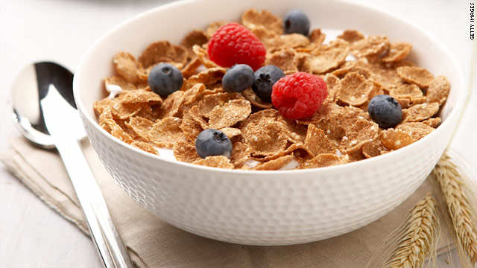
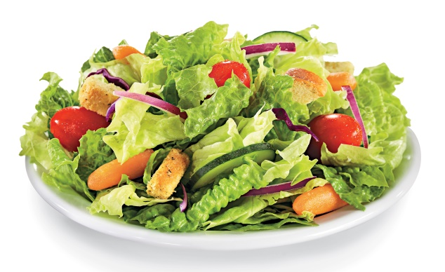
Problem of goal selection
Context
Notes:
One major problem
Given that we’re hungry, one possible goal is to make a sandwich
But there are other possible goals: make cereal, a salad
Problem is worse than this
Infinite set of goals; can’t check each one

Slide 5
Planning towards goals
Subsubgoals
Subgoals
Goal
Context
Notes:
Same problem applies to choosing subgoals
How do we quickly select an appropriate goal?

Slide 6

Solution: habits
In cage
Get reward
Push lever
Habitual action
(Dolan & Dayan, 2013)
Notes:
One solution comes out of the literature on habits.
Habits are typically thought of as stimulus-response patterns which get stamped in by reward.
For example, suppose you have a rat in a cage. Every time it pushes a lever, it gets food. If it does this enough times, it will learn to push the lever even when it’s not hungry; pushing the lever has just become a habitual action, regardless of what it leads to.

Slide 7
Solution: habits
Hungry
Select sandwich goal
Get reward
Habitual goal
Notes:
What if the same system could select goals instead of actions?
The goals would become habitualized

Slide 8
Solution: habits
Goal: sandwich
Select subgoals: bread, cheese, ham
Get reward
Habitual subgoal
Notes:
Same thing applies to subgoals
Efficient, but insensitive to changes in causal knowledge

Slide 9
Testing for habitual goal selection
Goal-directed planning
1
2
If $x > $y, plan towards
If $y > $x, plan towards
Habitual action
Has
1
or
2
$x
$y
$z
led to more reward?
Habitual action system uniquely predicts increase in selecting action 1 after reward
(Gläscher et al. 2010)
Notes:
How do you test for this kind of mechanism?
We adapted a paradigm for distinguishing between goals and habitual actions
In the original paradigm, people play a game where they choose between two options, colors, drifting reward distributions. Thick lines, thin lines.
20% of the time…
How two systems work
Goal-directed
Habitual action
Critical trials
Suppose the person chooses 1, transitions to orange, and gets a big reward.
A goal-directed planning system would ignore the reward, b/c both options have the same low chance of getting to orange.
But a habitual action system would be more likely to choose 1 on the next trial, because it was associated w/ reward.
So, on the next trial…

Slide 10
Testing for habitual goal selection
Goal-directed planning
1
2
3
4
If $x > $y, plan towards
If $y > $x, plan towards
Habitual action
Has
1
2
3
or
4
$x
$y
$z
led to more reward?
Habitual goal
Habitual goal system uniquely predicts increase in selecting action 2 after reward
Has planning towards
or
led to more reward?
Notes:
To isolate the effect of habitual goals, we made two actions for each color goal.
On every trial, gave them 2 out of the 4 options to choose from.
Suppose person is presented with options 1 and 3, and chooses 1. Transitions to orange, gets a big reward.
On next trial, presented with options 2 and 4.
A traditional goal-directed planning system wouldn’t be affected.
Neither would habitual action.
But habitual goal..

Slide 11
Testing for habitual goal selection
*
Goal selection can be habitual
Notes:
Explanation of effect
Implication

Slide 12
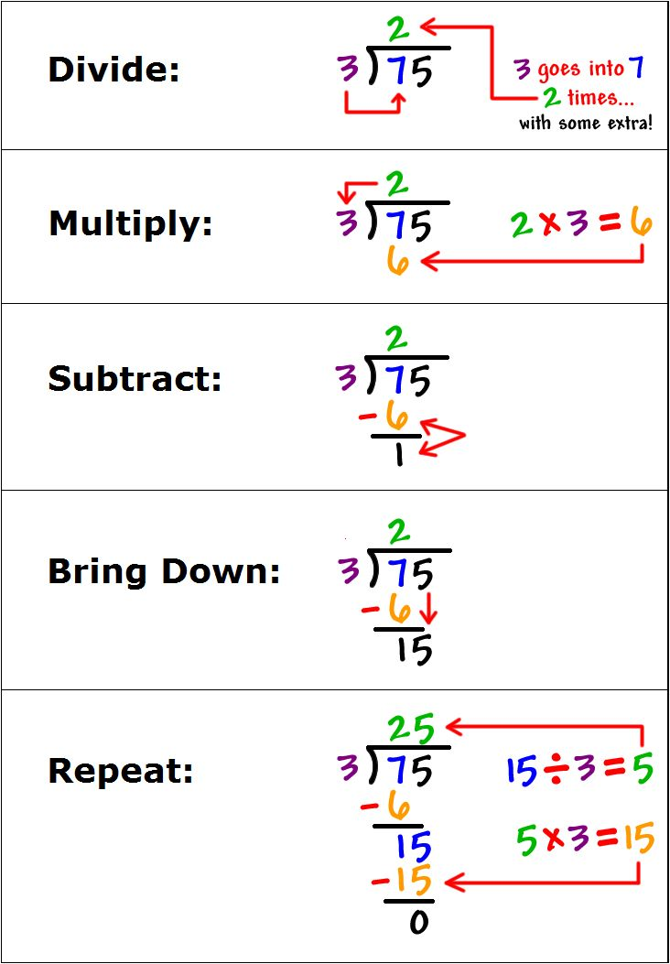

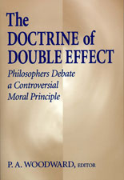
Applications
Notes:
Addiction
Complex cognitive tasks
Doctrine of double effect

Slide 13

Thank you!
In collaboration with:
Fiery Cushman
Contact: adammorris@g.harvard.edu

